Slide 1

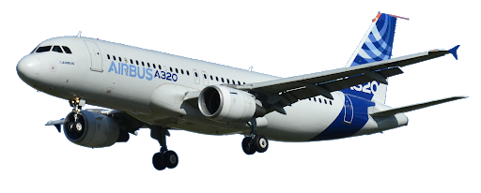
company analysis
Made by PI18E group students:
Džiugas Pečiulevičius,
Lukaš Jutkevič &
Evaldas Paulauskas

Slide 2
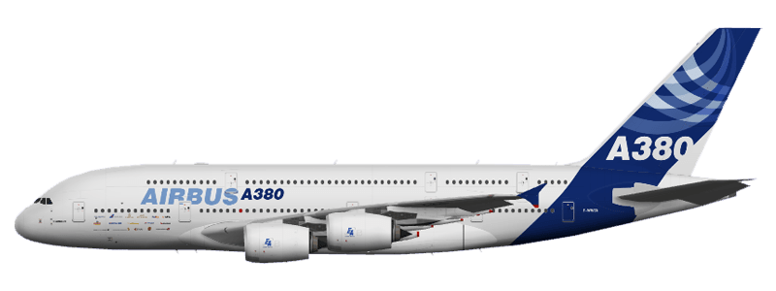
introduction
In this project we analyze Airbus business sector, its changes and its influencing factors, volume of the sector and main competitors. Calculate 12 main ratios for Airbus and use Z-Altman’s formula to help determine the financial health of a company.

Slide 3
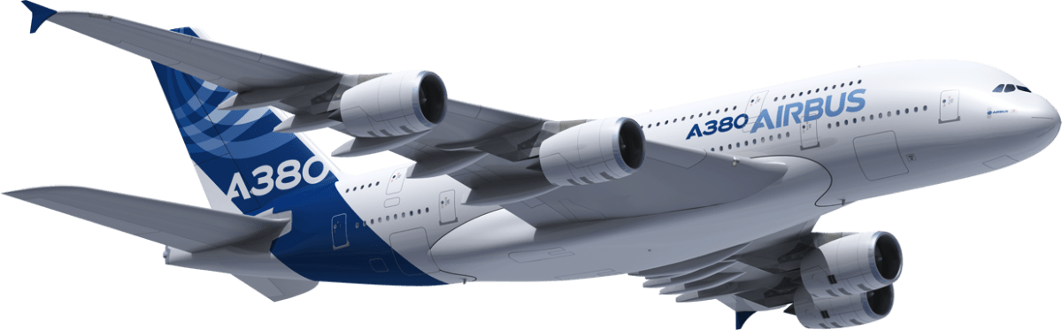
Analysis of business sector
Airbus is a tertiary sector. Tertiary sector is also called a service sector which involves the selling of goods and products.
Airbus is a European aircraft-manufacturing association formed in 1970.
Airbus is now one of the world’s top two commercial aircraft manufacturers competing with American company - Boeing.
2018 was the year when Airbus operated as one company after the completion of the Airbus Group and Airbus integration.

Slide 4
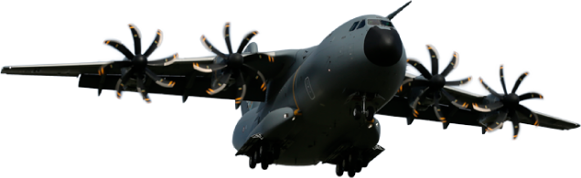
Analysis of business sector
Airbus also provides tanker, combat, transport and mission aircraft. It’s also one of the world’s leading space companies with consolidated revenues of €63.7 billion in 2018.
In 2018 Airbus generated 84.5% of its total revenues in the civil sector (85% in 2017) and 15.5% in the defense sector (15% in 2017).
As of December 31st, the company’s active headcount was 133,671 employees.

Slide 5
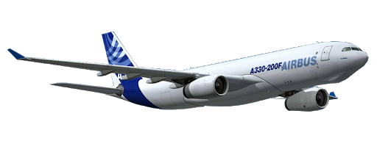
Volume of the sector
The global aerospace industry was worth $838 billion in 2018:
Aircraft and Engine parts manufacturing represented 28% of the sector value (about $235 B)
Civil & Military aircraft maintenance and upgrades represented 27% (about $226 B)
Aircraft Systems and Component Manufacturing represented 26% (about $218 B)
Satellites and Space represented 7% (about $59 B),
Missile & Military Drone production and maintenance represented 5% (about $42 B)
Other activity, such as flight simulators, defense electronics, public research accounted for 7% of the market volume (about $59 B).

Slide 6
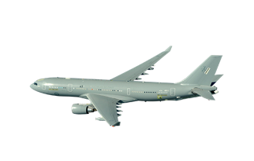
Analysis of industry competitors
Airbus Group is a multinational aerospace and defense company which means that it doesn’t really have any local business competition.
Main global competitors in A&D sector are:
Boeing - American corporation that designs, manufactures, and sells airplanes, rotorcraft, rockets, satellites and other A&D products.
Lockheed Martin - American A&D corporation with worldwide interests that mainly focuses on defense contracts.
Northrop Grumman Corporation - is an American global A&D technology company.
GE Aviation - a subsidiary of General Electric is among the top aircraft engine suppliers and offers engines for most commercial aircraft.

Slide 7
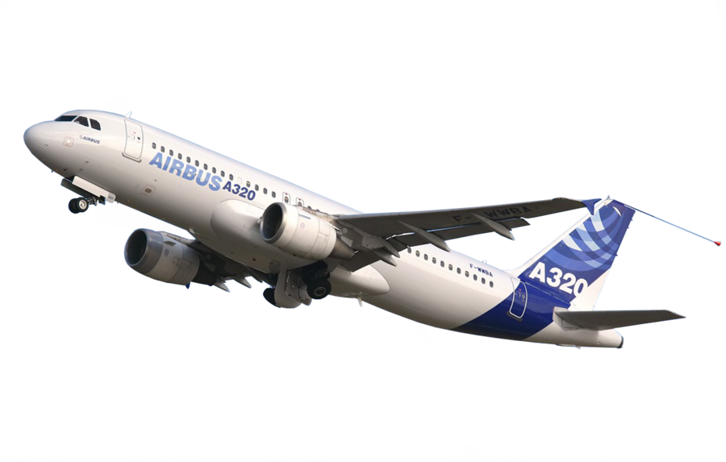
Civil aerospace sector
According to the manufacturers’ published figures for 2018, Airbus and Boeing, each accounted for 50% of total commercial aircraft deliveries, 46% and 54% of total net orders (in units), and 56% and 44% of the total year- end backlog (in units). With 800 deliveries, 2018 was Airbus’ 16th year in a row of increased production

Slide 8
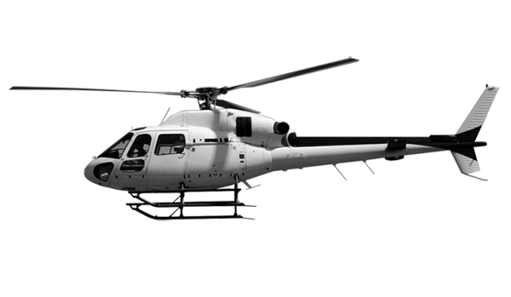
Airbus helicopters
Airbus Helicopters has maintained its leading market share (in bookings of 2.0t helicopters and five seats and above), in a low market, Customers with ~52% in unit in 2018, followed by Leonardo and Bell with respectively 26% and 13%.
Airbus Helicopters’ main competitors in the military sector are Sikorsky, Boeing and Russian Helicopters

Slide 9
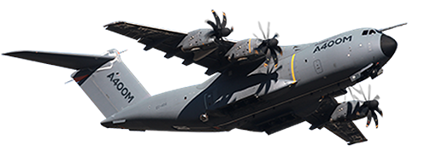
Military
The market for military aircraft is dominated by large and medium-sized American and European companies. The main competitors in military transport and mission aircraft include Boeing, Embraer, Lockheed Martin, Leonardo, UAC, Kawasaki, AVIC and Antonov
The aircraft is designed to disrupt the divide between strategic and tactical transport by offering both capabilities in one. This saves both time and cost as you can fly a long-range strategic aircraft into a tactical zone of operation. In terms of revenues, Airbus Defense and Space is the largest continental European combat aircraft manufacturer

Slide 10
Main company activities
Airbus is a multinational aerospace corporation. It designs, manufactures and sells civil and military aerospace products worldwide.
The company has three divisions:
Commercial Aircraft (Airbus S.A.S.), Defense and Space, and Helicopters, the third being the largest in its industry in terms of revenues and turbine helicopter deliveries.

Slide 11
Market size estimation
The long-term market for passenger aircraft depends primarily on passenger demand for air travel, which is itself primarily driven by economic or GDP growth, fare levels and demographic growth.
Airbus’ new Global Services Forecast predicts a US$4.6 trillion worldwide market for commercial aircraft services from 2018 to 2037. Analysis is based on a three-way market segmentation, respectively focusing on the aircraft, the airline operation, and the passenger experience.

Slide 12
Market size estimation
Preliminary figures released at the end of 2018, by the International Civil Aviation Organization (ICAO), confirmed that 4.3 billion passengers made use of the global air transport network in 2018.
The annual passenger total is up 6.1% compared to 2017 and the number of departures rose to approximately 38 million globally.
World passenger traffic, expressed in terms of total scheduled revenue passenger-kilometers (RPKs), posted an increase of 6.7% with approximately 8.2 trillion revenue passenger kilometers performed.

Slide 13
Market size estimation
In 2019 Airbus released rather optimistic long-term growth potential estimation, company predicts that market size will double in next 15 years. In 15 years, company expects to increase replace more than 10 thousand of its existing airplanes and sell more than 20 thousand.
Considering current situation with the impact of Covid-19 pandemic on global economy and airplane travel in 2020, it's predicted that total recovery from the pandemic effects on air travel may take up to 4 years.

Slide 14
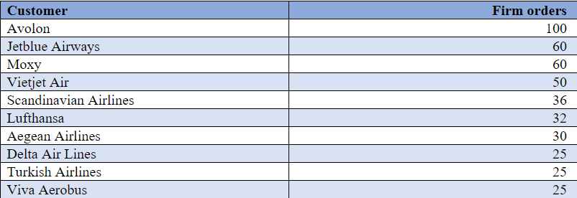
Targeted customer segment
As of 31st of December 2018 , Airbus had 414 customers and a total of 19,340 aircraft being ordered, of which 11,763 had been delivered to operators worldwide.
The table below shows Airbus’ largest commitments in terms of total gross firm orders by customer for the year 2018.

Slide 15
Targeted customer segment
With 54% of the worldwide market share-based on deliveries in 2018, the versatility and reliability of Airbus Helicopters products have made them the preferred choice of the most prominent civil and parapublic customers (turbine helicopters of five seats and above).
The Military Aircraft Programme Line with its products combat aircraft, military transport aircraft, mission aircraft and related services supplies the public sector, mainly armed forces.
Customer relationships in this segment are characterized by their long-term, strategic nature and long decision-making cycles. Once a contract is signed, its life span including considerable services business often amounts to decades. Beyond a strong foothold in home countries, the customer base is increasingly global, due to the success of the A330 MRTT and C295 programmes.

Slide 16
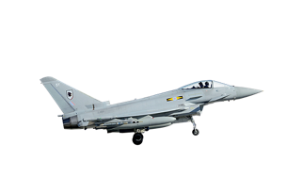
Products range, pricing & differentiation
Airbus' product line includes everything from commercial aircraft to freighters and private jets. Ranging from 100-seat jetliners to a double-deck A380 which can carry more than 850 people at a time.
Airbus Helicopters offers a complete range of helicopters that covers nearly the entire civil and military market spectrum, which it continuously improves with leading-edge technologies. This product range includes single-engine, light twin-engine, medium and medium-heavy helicopters, and is based on a series of new-generation platforms designed to be adaptable to both military and civil applications.
Airbus Defense is the largest defense supplier in Europe, and among the top 10 defense companies worldwide. Together, the A400M, C295, CN235, A330 MRTT and Eurofighter Typhoon make up a world-class product line operated by air forces worldwide.

Slide 17
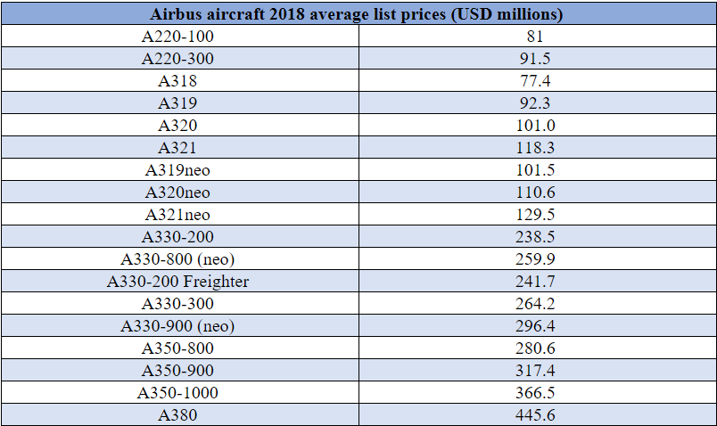
Products range, pricing & differentiation

Slide 18
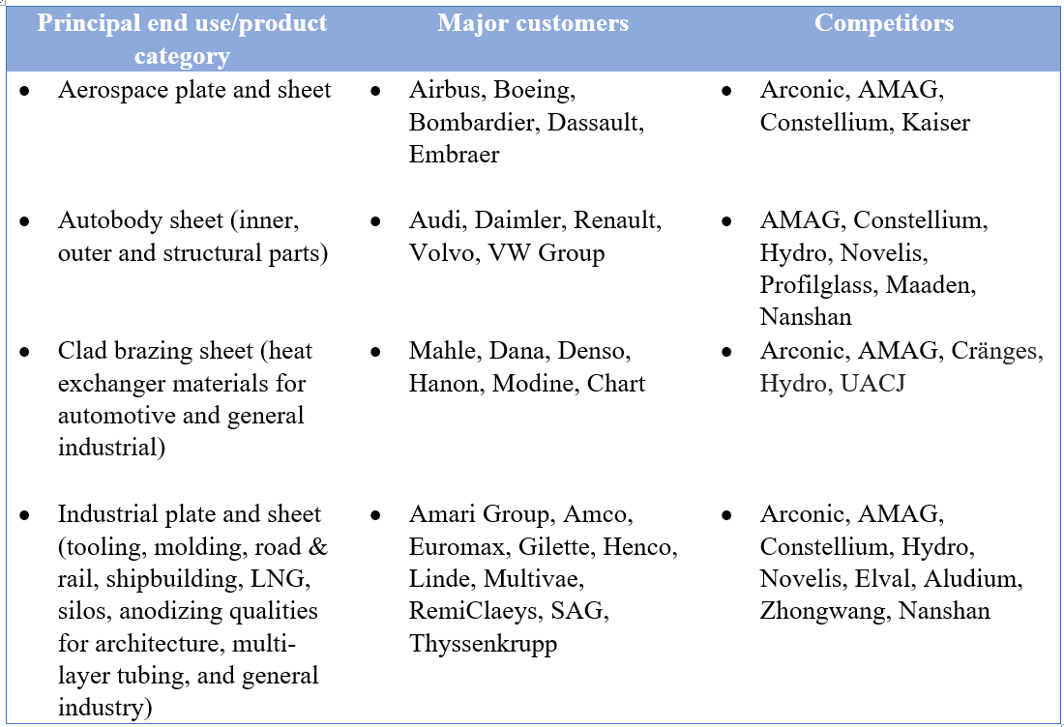
ANALYSIS OF COMPANY'S SUPPLIERS
Around 80% of Airbus' activity is sourced. The company works with more than 12,000 suppliers worlwide that provide products and services for flying and non-flying parts. Airbus continuously develops its supplier base, with an overall sourcing volume across the company valued at approximately €49.6 billion. Airbus has identified global sourcing as one of its long-term objectives and aims to source 40% outside Western Europe and the U.S. by 2020.

Slide 19
Organizational structure of the company
In 2018, the Company organized its businesses into the following three operating segments:
Airbus (formerly Commercial Aircraft)
Helicopters
Defense and Space.
The merger began mid-2017 and provided the opportunity to introduce a single Airbus brand for the Company and all its entities, effective since January 2017.
In 2017, Airbus Group SE’s name was changed to Airbus SE, following approval at the Annual General Meeting. In this new set-up, the Company retains Airbus Defense and Space and Airbus Helicopters as Divisions.

Slide 20
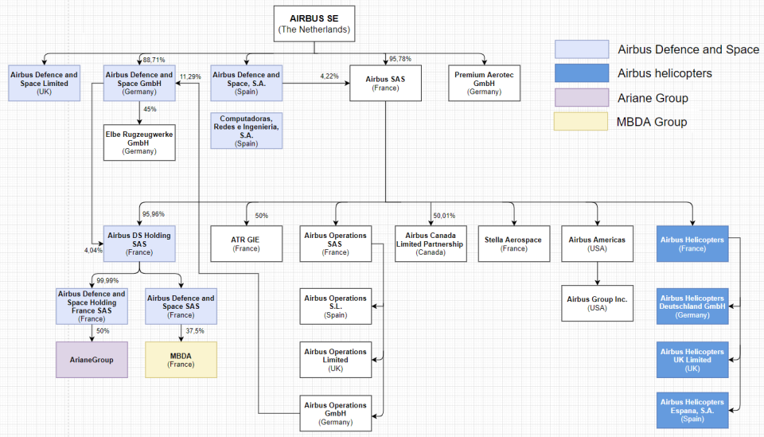
Organizational structure of the company

Slide 21
Future development opportunities
Airbus is currently on the path to a zero-emission flight.
In 2010, Airbus embarked on its electrification journey, developing the world's first all-electric, four-engine aerobatic aircraft.
In 2015 their all-electric, twin-propeller aircraft E-Fan successfully crossed the English Channel. E-Fan X, the successor to E-Fan that is 30-times more powerful than its predecessor.
This provides a great opportunity for Airbus to become a leader in future of aerospace industry by pioneering electrical or hybrid flight systems while concerns for air pollution and global warming rise higher and higher.

Slide 22
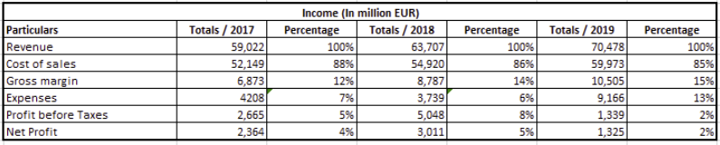
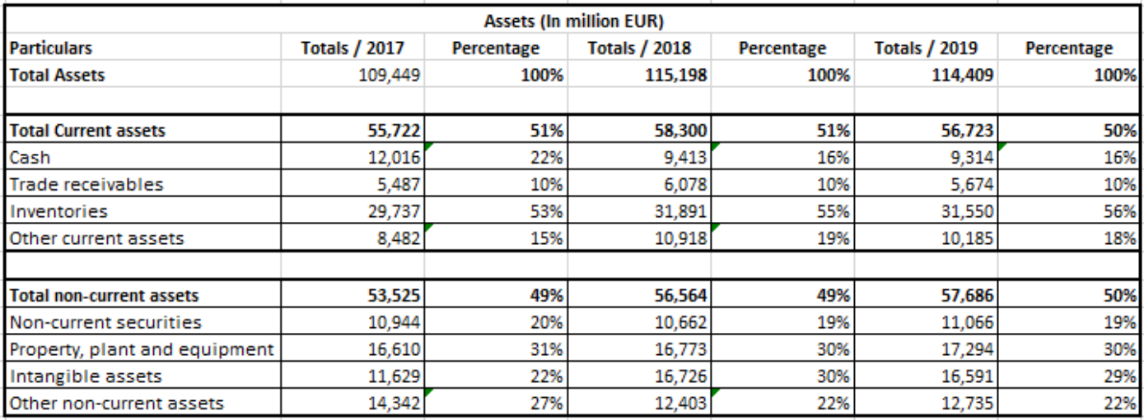
Vertical analysis

Slide 23
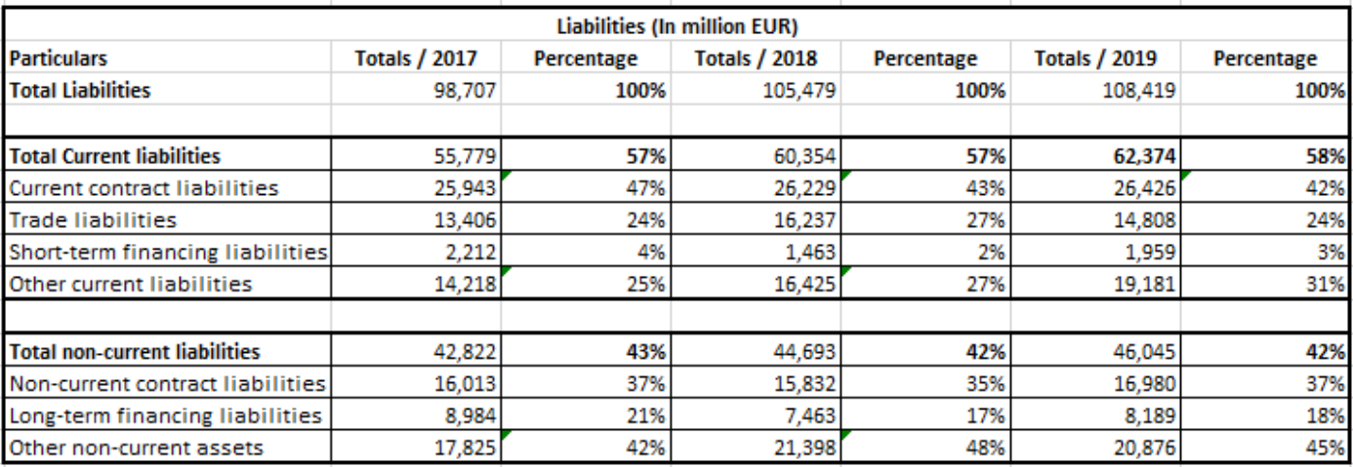
Vertical analysis

Slide 24
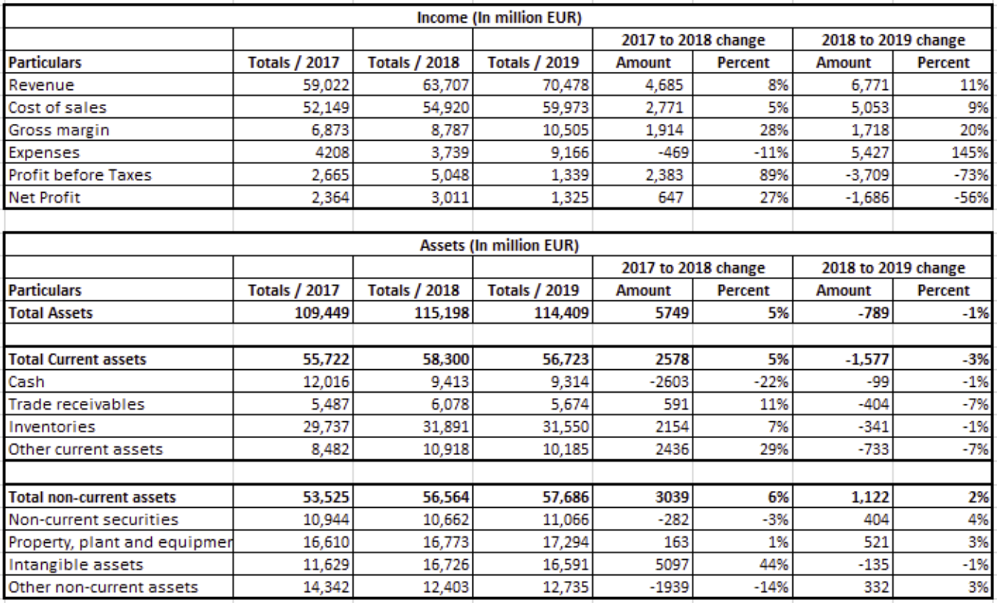
Horizontal analysis

Slide 25
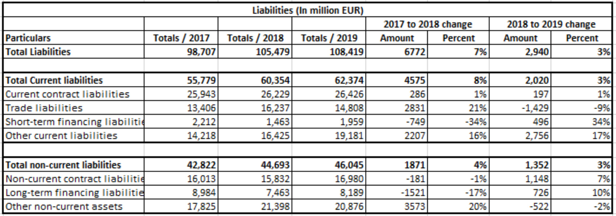
HORIZONTAL ANALYSIS

Slide 26
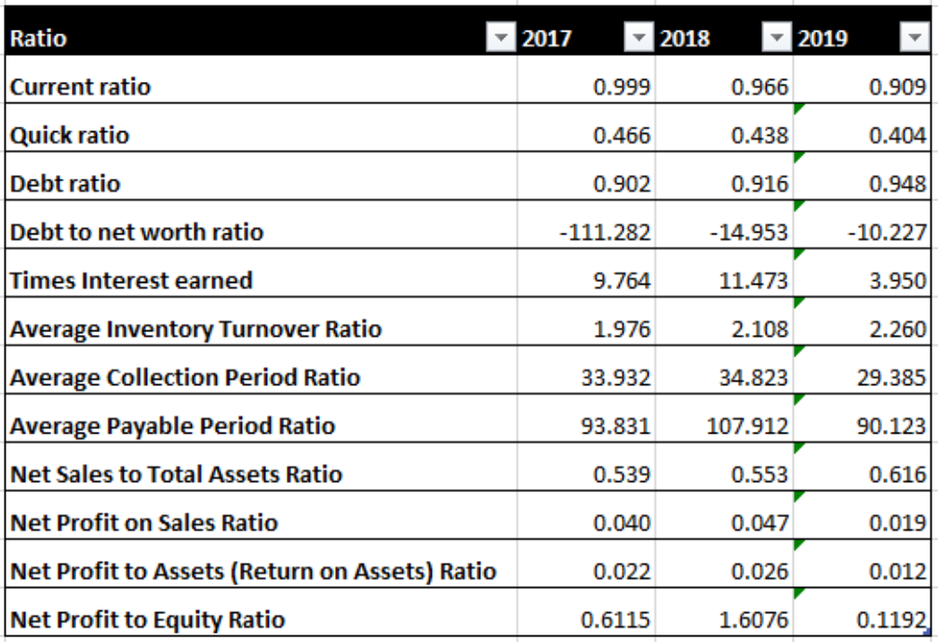
Twelve main ratios

Slide 27
Z-altman's coefficient for the bankrupt prediction
The Altman Z Score is used to predict the likelihood that a business will go bankrupt within the next two years. The formula is based on information found in the income statement and balance sheet of an organization.
Formula consists of 5 ratios each multiplied by weight to determine Z score:
A - Working Capital (Current Assets – Current Liabilities) / Total Assets (Measures liquidity of firm)
B - Retained Earnings / Total Assets (measures accumulated profits compared to assets)
C - Earnings Before Interest & Taxes (EBIT) / Total Assets (measures how much profit firms assets are producing)
D - Market Value of Equity (Mkt. Cap. + Preferred Stock) / Total Liabilities (compares the company’s value versus its liabilities)
E - Sales / Total Assets (efficiency ratio – measures how much the company’s assets are producing in sales).

Slide 28
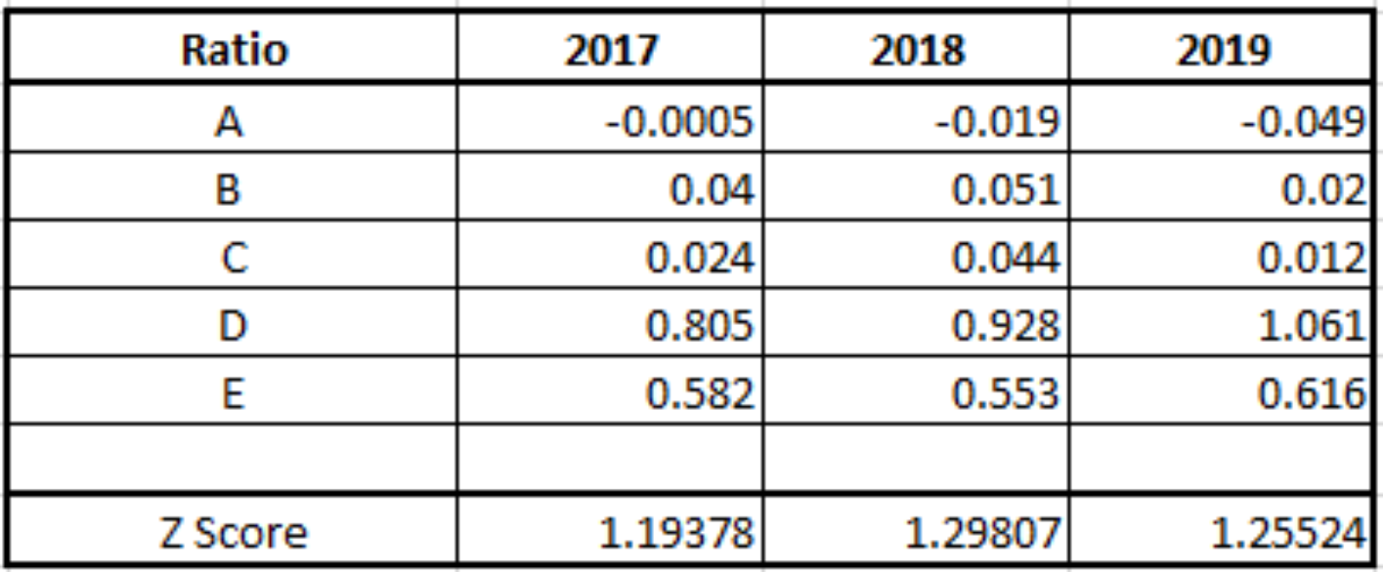
Z-altman's coefficient for the bankrupt prediction
Z-Score Results:
Z-Score of < 1.81 represents a company in distress.
Z-Score between 1.81 and 2.99 represents the “caution” zone.
Z-Score of over 3.0 represents a company with a safe balance sheet.
Following formula is used to calculate the coefficient:
Z = 1.2A x 1.4B x 3.3C x 0.6D x 0.99E

